Slide 1


Predicting Retail Gasoline Prices at a Weekly Frequency in the United States
Emine Erdogan
Springboard, 2023

Slide 2
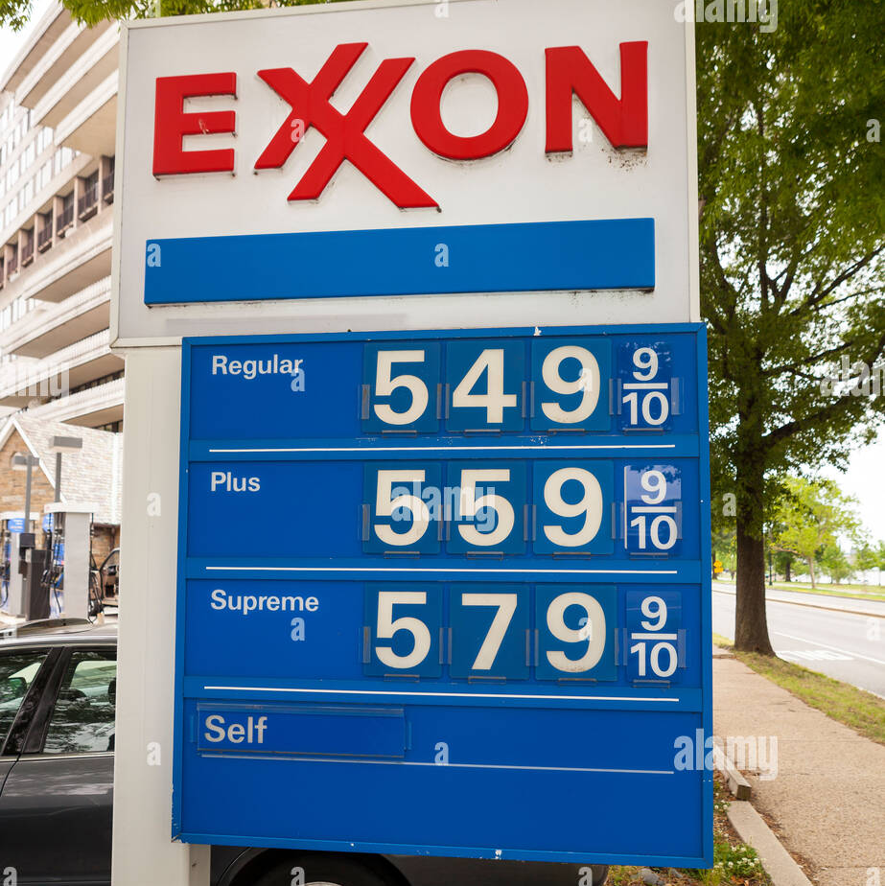
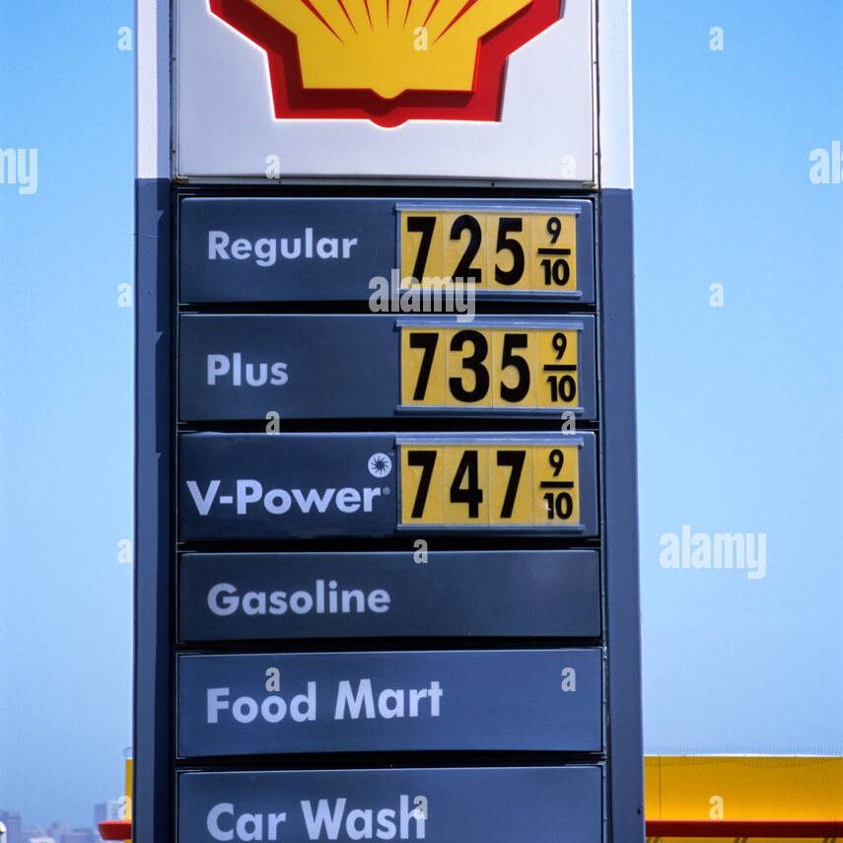
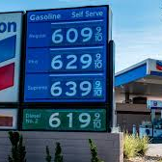
Agenda
Introduction
Dataset
Data Wrangling
Exploratory Data Analysis
Models & Prediction
Conclusion

Slide 3



Introduction
The average global gasoline price: $1.32 per liter, $93 per barrel
North America - the largest market share, the Asia-Pacific region - second.
The increasing demand for high-speed cars and small aircraft of private planes
Gasoline market value: USD 125,000 million in 2021
Expected to reach USD 140,811.6 by 2029 (Data Bridge Market Research)

Slide 4

- Oil prices have a considerable impact on food price movements => up to 64% - Inflation - Production costs - Global growth - Social unrest - Accurately predicting the fluctuations are essential for both individuals and organizations to make informed decisions.
Introduction

Slide 5

Problem Statement
What are the current trends in gasoline prices and what will be the optimal forecast value for gasoline prices for next 2 years?

Slide 6

Dataset
Weekly updates on gasoline prices in USA over the past 23 years ➔1228 rows (1999 – 2022) -17 columns
Date
Distribution costs, and profits
Crude oil cost
Refinery costs and profits
State underground storage tank fee
State and local sales tax
State exercise tax
Federal exercise tax
Average retail prices
Price
➔ Branded Fuel Prices (BFP) + Unbranded Fuel Prices (UFP)/2

Slide 7
Data Wrangling
Missing Data
Date to DatetimeIndex
Renaming Columns
3 missing data are filled in with the prices from the previous week.
Changing the ‘Date’ column into DatetimeIndex and assigning it as the index of the dataframe.
14 columns are dropped. Price and Date columns kept.
Dollar values are converted to integer.

Slide 8
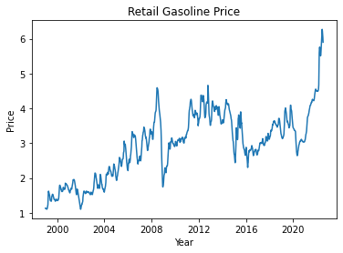
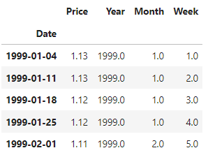
Exploratory Data Analysis

Slide 9
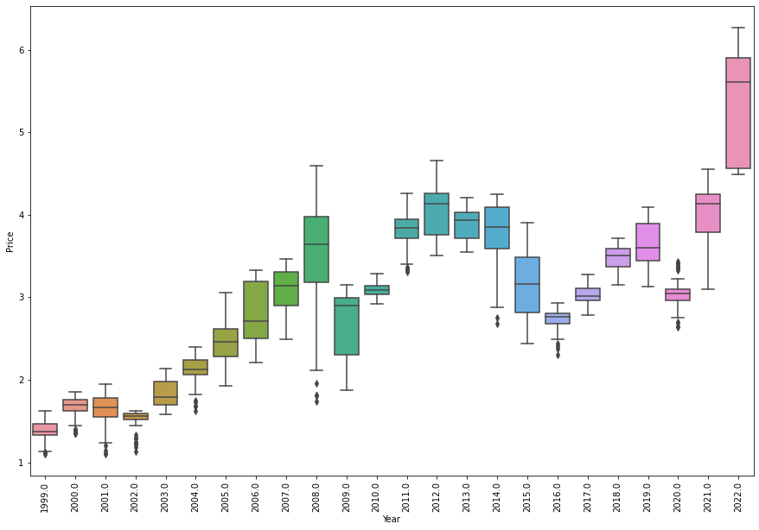
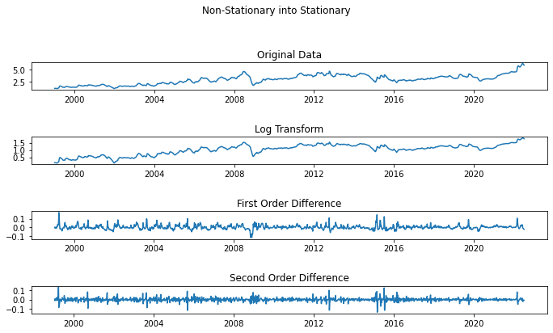
Outliers & Stationarity
- Increasing trend in the data => the series is a random walk.
- ADF Test => Difference and the log of Price column at the same time => Stationarity in the data
No significant outlier detected.

Slide 10
Data Split
Train Data
January 4, 1999 - October 23, 2017
(~First 18 years)
Train + Validation
January 4, 1999 - October 21, 2019
Test Data
October 28, 2019 - November 7, 2022. (~Last 5 years)
Forecast
November 14, 2022 - April 2, 2028,
(~ Future 5 years - 20% of the data)

Slide 11
Models
three major prediction tools
Three components of Time Series Analysis
Trend
Error
Seasonality
ARIMA relies on past values
Exponential Smoothing predicts the next period value by utilizing past and current values
Facebook Prophet utilizes an additive model incorporating yearly, weekly, and daily seasonal patterns, along with holiday effects.

Slide 12
Model Performance Metrics
Four Metrics of Model evaluation
MSE
MAPE
MAE
RMSE
For this project, the performance of the models will be measured by using MAPE metric.
MAPE => mean absolute percentage errors between predicted and actual values.
MAPE is scale-independent metric, and it is easy interpret.
Less than 5% MAPE is considered as an indication that forecast is acceptably accurate.

Slide 13
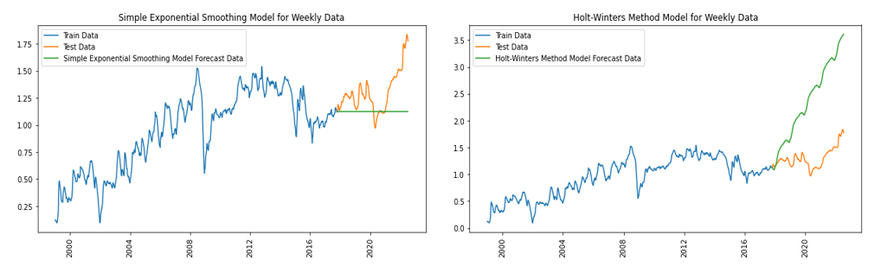

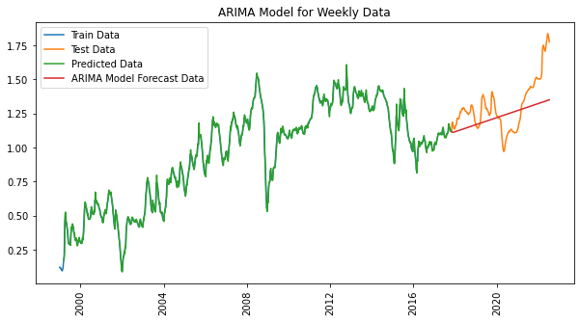
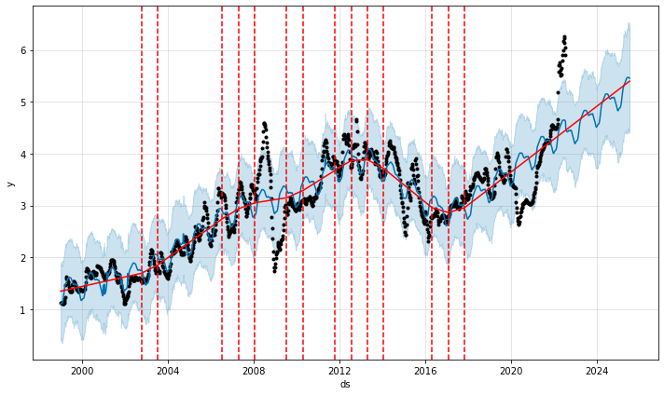
Winning Model - ARIMA
Facebook Prophet Model for Weekly Data
Exponential Smoothing
MAPE: 0.13
ARIMA (2,2,2)
Facebook Prophet
MAPE: 0.1
MAPE: 0.14

Slide 14

Conclusion
This time series analysis project was designed not only to better understand how gasoline price changes over time, but specifically to utilize machine learning tools to predict the future price values.
According to the analysis of these three models, ARIMA has the lowest MAPE score and presents the best model accuracy. Therefore, we selected ARIMA as the best model to predict gasoline prices.

Slide 15
Thank You!

